Slide 1
IST 659 - Final Project Presentation
Insurance Management System
Members:
Bhavya Shah
Jenil Sheth
Ritik Dhame
Rohan Shah

Slide 2
PROJECT OVERVIEW
The aim of the project is to create a database management system for a branch of an Insurance company to get rid of the traditional paper based records and provide an easy access digital solution to the policyholders as well as insurance agents.
The system stores details of admins, agents, payment records, plans, policy, and policyholders.

Slide 3
GOALS
The project aims to create a database management system for a branch of an Insurance company to provide easy access to the policy data. The system stores details of admins, agents, payment records, plans, policy, and policyholders.
The branch can have many admins and each admin can have many agents.
Admin can maintain records of agents and also check the premium of every customer.
It will be easier for the admins and agents to keep track of the insurance details for all the customers, hence making the system efficient.
Since the system requires login credentials, it will ensure Data security.

Slide 4
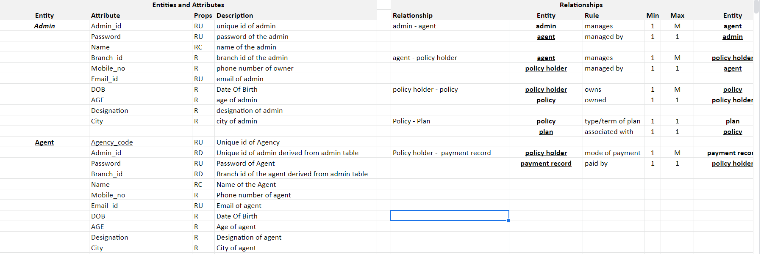
ERD DATA REQUIREMENTS/BUSINESS GOALS

Slide 5
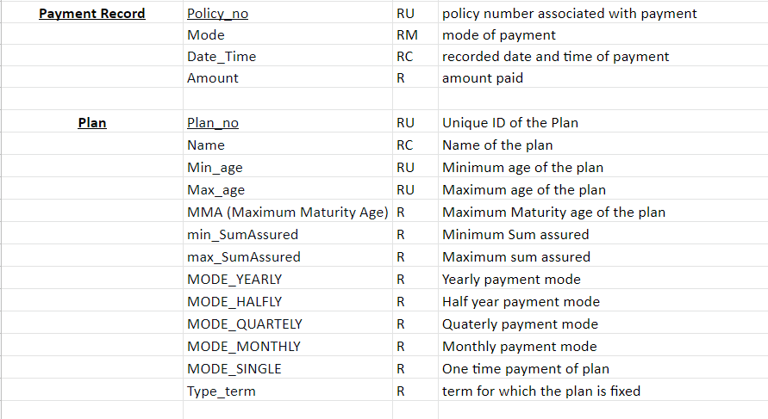
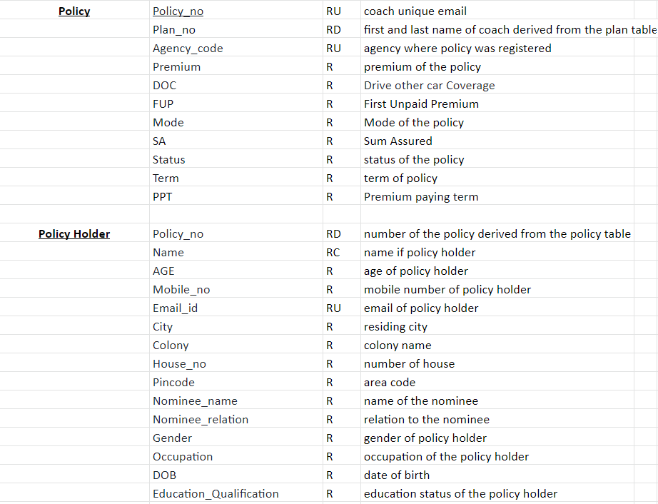
ERD DATA REQUIREMENTS/BUSINESS GOALS

Slide 6
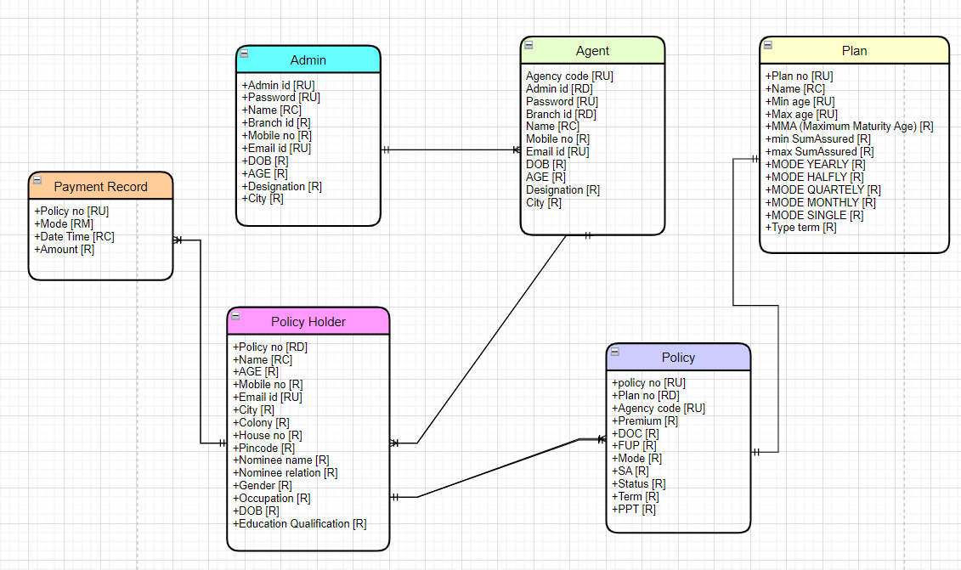
CONCEPTUAL MODEL

Slide 7
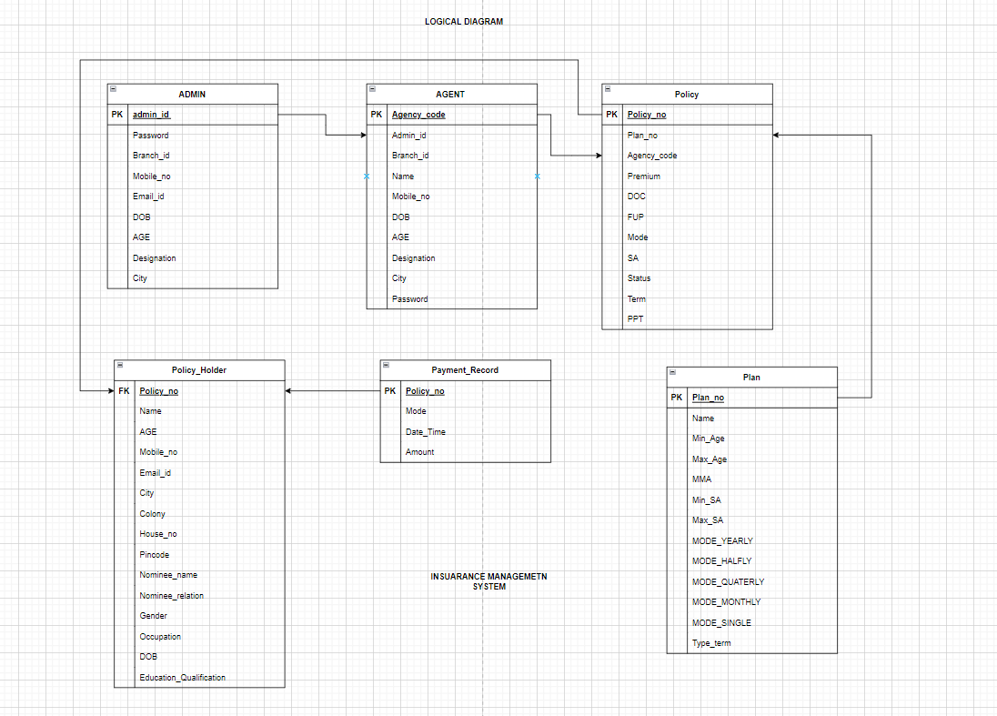
LOGICAL MODEL
We have included the following tables such as ;
ADMIN
AGENT
POLICY
Policy_Holder
Payment_Record
Plan

Slide 8
THANK YOU

